Slide 1
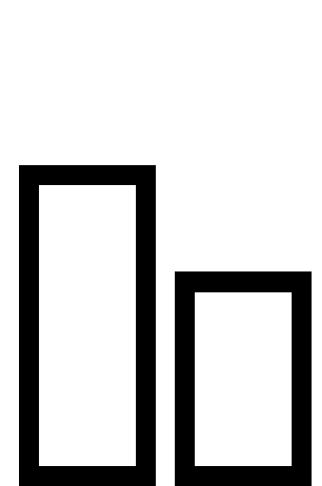
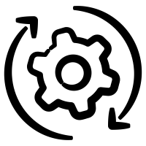
MODELS
EXPERIMENTS
DATA
. . . 1 1 1 1 0 0 1 1 0 0 1 1 1 1 0 1 . . .
0
1
Classical
Frequentist
P(E)
fr(E)

